Slide 1
Product Recommender using Amazon Review Dataset
By
Saurabh Kumar Pradhan (200250329013)
Kruti Vijay Singh (200250329014)

Slide 2
Problem Statement
To build a recommendation system for products on an e-commerce website, considering the customer reviews made on the products using the amazon review dataset.
Test the accuracy and check for new data.

Slide 3
Tools and Languages
Language : Python 3
Environment : Jupyter Notebook
Technologies : Machine Learning Algorithms and Natural Language Processing.
Dataset : reviews_Office_Products.json
“Amazon product data” Julian McAuley, UCSD containing data from May 1996 - July 2014.

Slide 4
Introduction
Online stores like Amazon, Flipkart have millions of products available in their catalogues. Deciding the right product becomes tricky, because of this Information overload". Users get confused, and this puts a cognitive overload on the user in choosing a product.
Recommender system helps in predicting the probable future outcomes and similar interests by leaning from historic data .
For Example : Recommender system has the ability to predict whether a particular user would prefer an item or not based on the user's profile.
Recommender systems are beneficial to both service providers and users
Amazon, a pioneer in the use of collaborative recommender systems, offers “a personalized store for every customer” as part of their marketing strategy.

Slide 5
Proposed system
Proposed system will generate recommendations based on the reviews
The Proposed system will aim to deliver the better results as compared to the traditional recommender systems which take only ratings into account.
The reviews will undergo Sentiment Analysis
This will help monitor the product sentiment in customer feedback and understand customer needs.
Similar products based on the reviews made.
Collaborative filtering technique(Item – Item ) using K-Nearest Neighbors algorithm

Slide 6
How?
The proposed system is divided to 2 broad categories
Preprocessing
Data Preprocessing
Data Cleaning
Predicting
Sentiment Analysis
Collaborative Filtering (Item based)
Review Score Predicting

Slide 7
Data Preprocessing
Sr. No. | Name(value) | Type(datatype)
1 | reviewerID | STRING
2 | asin | STRING
3 | reviewerName | STRING
4 | helpful | LIST
5 | reviewText | STRING
6 | overall | INT
7 | summary | STRING
8 | unixReviewTime | STRING
9 | reviewTime | STRING
Read data given in compressed json.gz file
Convert to dataframe
Helpful data to numeric column
Handle missing values
If reviewer name is empty fill-up with ‘Anonymous’
Padding
Handle duplicate
Drop duplicates
Convert to csv

Slide 8
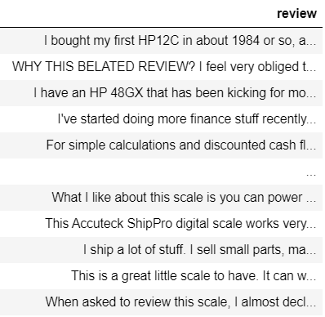
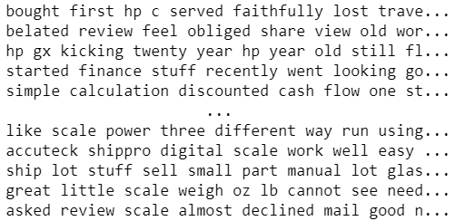
Data Cleaning NLP
Use of Regular Expression to remove unwanted numbers and symbols
Remove stopwords
Lemmatize the words

Slide 9
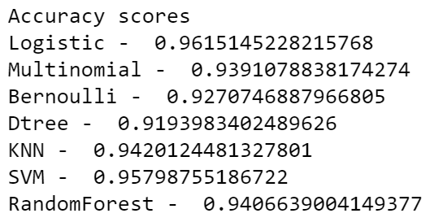
Sentiment Analysis
Label data with rating 3+ as positive and rest as negative
Split to test and train
Predict data with Logistic Regression , KNN , D tree , Random Forest , Multinomail Naiyve Bayes , Bernoulii Naiyve Bayes and SVM
Check accuracy of all models
Choose the one with the best i.e. Logistic Regression
Check for confusion matrix and precision

Slide 10
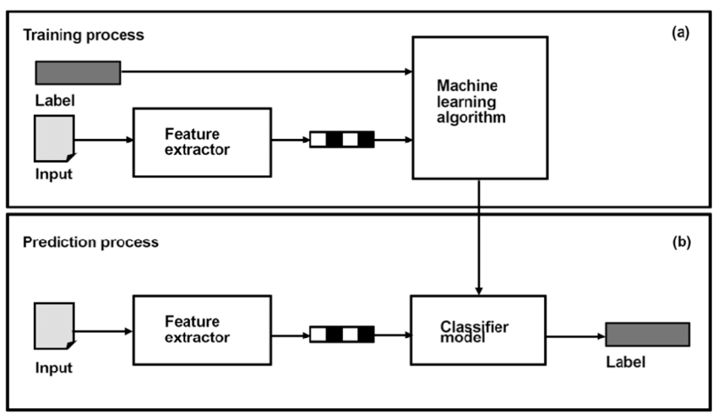
Sentiment Analysis
Take new reviews
Perform sentiment analysis with the model chosen making use of the new data as test data
Classify and display the polarity or probability of Positive and negative sentiment.

Slide 11
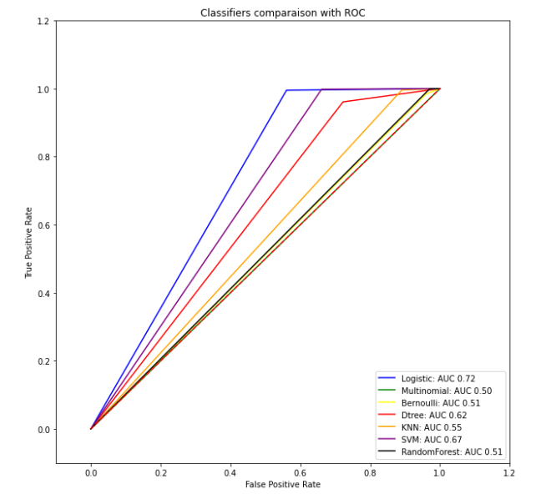
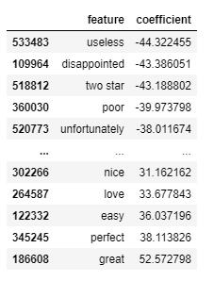
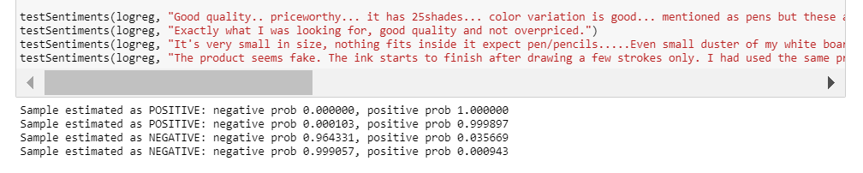

Slide 12
Collaborative Filtering
Grouping and merging data based on number of reviews for each product.
Extracting review and summary as text along with rating (grouped)
Cleaning text with regular expression, stopwords removal and lemmatization.
Vectorizing text data and transforming it
Splitting data to test and train (reviewdata and rating data)
KNN to find the two most similar products.
Using KNN algorithm with neighbors set to 5 and 3 to check for the most accurate clustering
KNN uses train set of review data and train set rating data set to train
Checking the accuracy and confusion matrix for each model

Slide 13
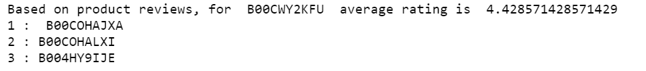
Similarity Matrix (Item based)
Replace sentiment positive and negative as 0 and 1 respectively
Label Encoder for product ID and review ID
Transformed table as index – asincode , columns as reviewercode, and values as sentiment
Fill the nan values with zero
using cosine similarity produced item to item similarity matrix

Slide 14
Similarity Matrix(User based)
Using the label encoded table produced in the previous process
Transformed table as index –reviewercode , columns as asincode , and values as sentiment
Fill the nan values with zero
using cosine similarity produced user to user similarity matrix based on sentiments

Slide 15
Thank You

